Slide 1
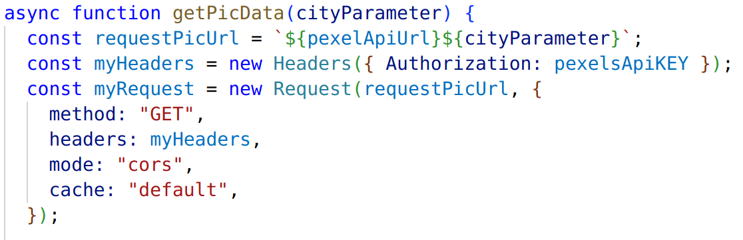
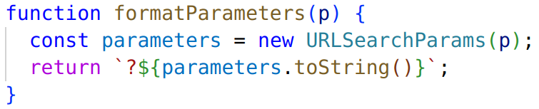
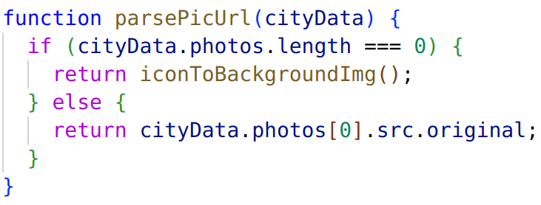

TW project: “Weather App” - Problems
Missing autorization
in request Header
Format Parameters
Error: imageSrc - undefined
Friday, January 27th 2023
Slide 0
San
Zinaida

Slide 2
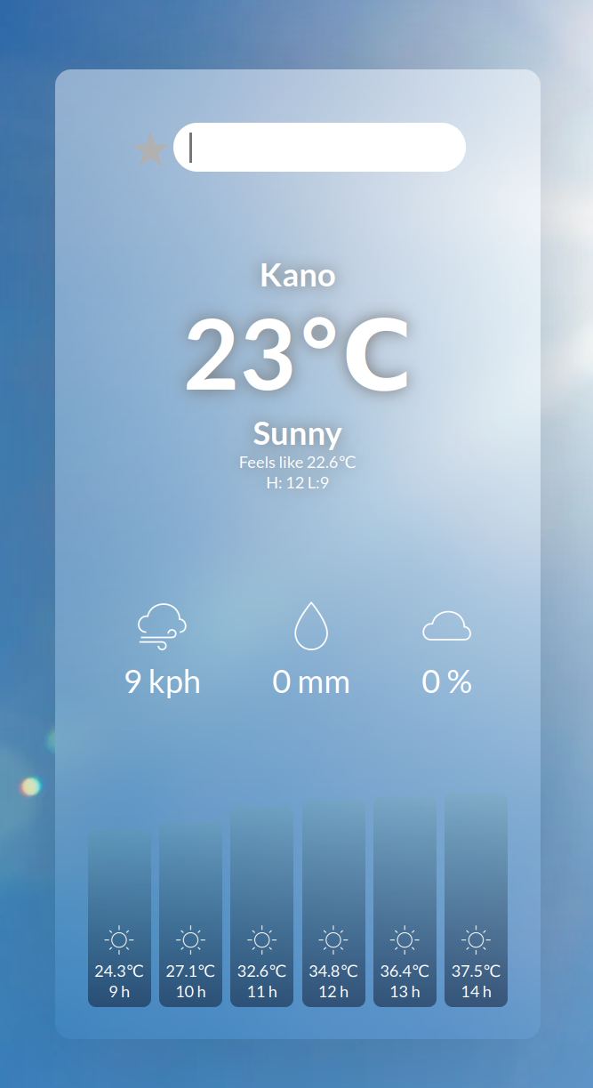
TW project: “Weather App” – Code structure
Input field
Fetch: weatherApi + parameters
populateList (locations)
save favorites
weather-box
updateWeather(city)
getWeatherData(city)
renderWeatherData(data)
weather-extra
changeBackgroundPic(city)
getPicData(city)
change background
weather-hourly
background
Friday, January 27th 2023
Slide 0
San
Zinaida

